Slide 1
Chapter 13: Hominin evolution

Slide 2
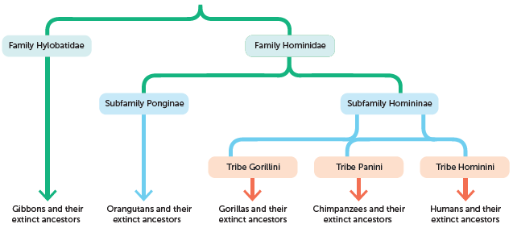
13.1 Evolutionary trends in hominins
The apes, including humans, have the same basic characteristics and are classified in the family Hominidae. However, humans differ from other apes in their appearance and structure. Each animal species has developed adaptations that help it to survive and reproduce in its particular environment.
Humans are classified as hominins; they belong to the tribe Hominini.
Hominins differ from other apes in their appearance, structure and behaviour.
Classification of apes, including humans

Slide 3
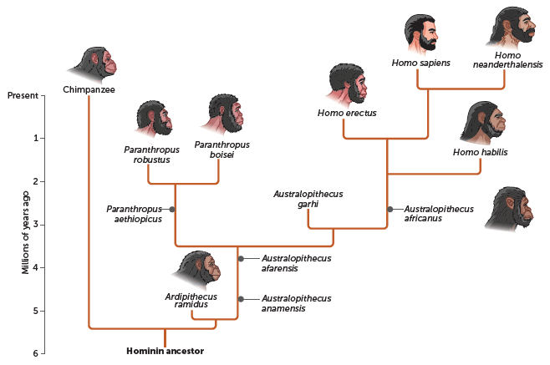
13.1 Evolutionary trends in hominins
Illustration reflecting the evolution of hominins

Slide 4
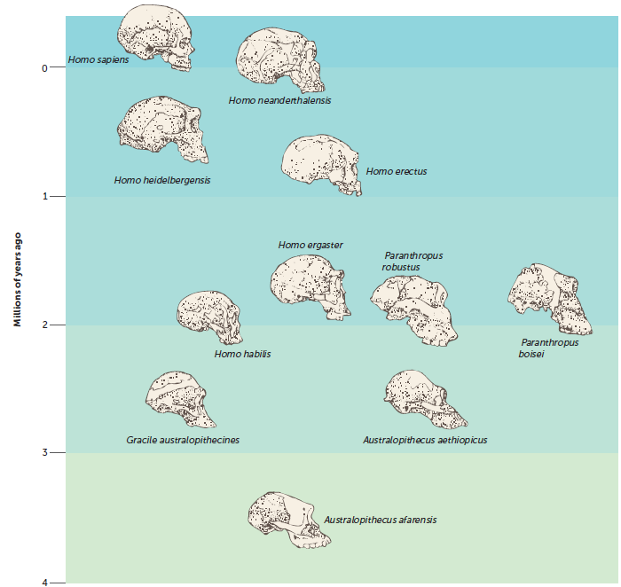
13.1 Evolutionary trends in hominins
During human evolution there is a general trend of increasing cranial capacity and skull size along with reduced prognathism. Homo sapiens also have a reduced brow ridge compared to earlier species.

Slide 5
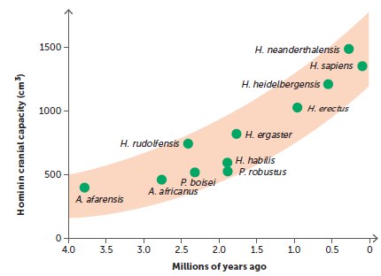
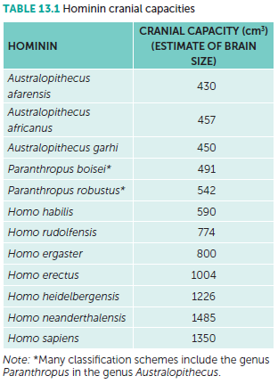
13.1 Evolutionary trends in hominins
Relative size of the cerebral cortex
The gradual increase in the size of the cranium to house a larger and more complex brain is an evolutionary trend in hominins. Endocasts have been used to calculate the cranial capacity of fossilised skulls. This has enabled scientists to infer that early hominins such as Australopithecus afarensis had a cranium that was much closer in size to that of modern apes than modern humans.
Subsequent fossil evidence confirmed a gradual increase in cranial capacity as the hominin species evolved towards modern humans.

Slide 6
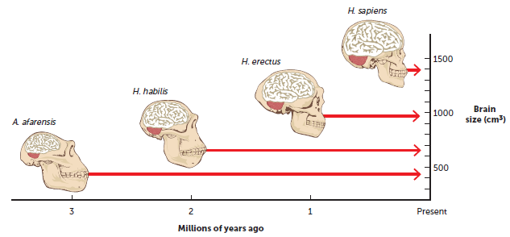
13.1 Evolutionary trends in hominins
The endocasts of australopithecines also indicate that their foramen magnum was more forward than it is in the apes, and the skull more rounded at the back.
Fossil endocasts also reveal a gradual increase in the number of convolutions and the size of the frontal lobe. These trends can be seen in Homo erectus fossils. Over the period of time that this species lived on Earth, the cranial capacity of H. erectus increased from about 750 cm³ to 1250 cm³. As the brain case expanded, the face tended to become flatter and a noticeable forehead began to develop in the later members of the species. This was probably due to an expanding frontal lobe.

Slide 7
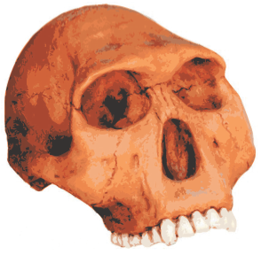
13.1 Evolutionary trends in hominins
Prognathism and dentition
Early hominins, such as Australopithecus afarensis, had a lower jaw and face that was more like that of other apes. The teeth were large and there was a distinct gap between the canines and the incisors, with the rows of teeth parallel rather than curved. However, by the time of Homo habilis, the molar and premolar teeth had become smaller and narrower, but the canines were still prominent.
The trend towards smaller molars and a decrease in the robustness of the teeth continued in Homo erectus and is noticeable in modern humans. Humans that lived about 100 000 years ago had teeth that were about 10% larger than humans of today. Modern humans also appear to be gradually losing their wisdom teeth (the third molar), with an increasing number of people having no wisdom teeth at all.
Fossil skull of Homo habilis

Slide 8
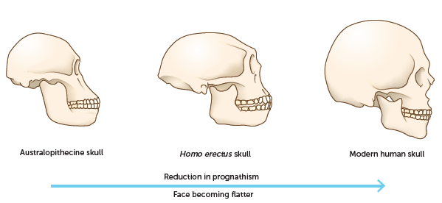
13.1 Evolutionary trends in hominins
This diagram shows the gradual enlargement of the cranial portion of the skull to accommodate the increasing size of the frontal region of the brain. This led to a more distinct forehead and to a reduction in prognathism and in the size of the brow ridge.

Slide 9
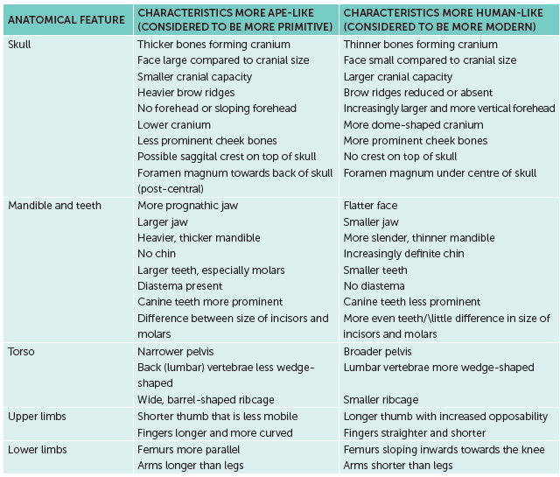
13.1 Evolutionary trends in hominins
Anatomical trends in hominin evolution

Slide 10
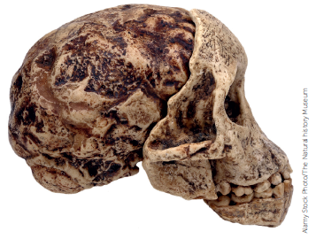
13.2 Comparison of hominin species
Genus Australopithecus
Fossil evidence of australopithecines
The first australopithecine fossil was found in southern Africa in the early 1920s and sent to Australian anatomist Raymond Dart. Dart was surprised to find the whole face, jaws and teeth of what appeared to be an ape. However, it was like no other ape: although it was a juvenile, Dart realised that the face was not as protruding as that of an ape, and the teeth, especially the first molars, were more like those of humans. The skull was more rounded, and there was no brow ridge.
Dart’s account of his discovery was published in Nature early in 1925. In his article, Dart suggested that the skull should be named Australopithecus africanus, ‘the southern ape of Africa’, and that it be put in a new family midway between apes and humans.
Alamy Stock Photo/The Natural history Museum
The Taung skull: Side view of a cast of the original fossil material

Slide 11
13.2 Comparison of hominin species
The Laetoli footprints are evidence that early hominins existed over 3 million years ago. Although there have been a number of interpretations of these footprints, with different numbers and sexes for the individuals who made them, most scientists agree that they were made by Australopithecus afarensis (a separate species of australopithecines) 3.56 million years ago. The footprints indicate a bipedal form of locomotion.
Another important discovery was the fossil remains known as ‘Lucy’, which were found in the Hadar region of Ethiopia, along with several hundred fossil fragments. The fragments are thought to be of individuals who lived and died near a now-vanished lake between 3 and 3.6 million years ago. 'Lucy' is a female skeleton that was 40% complete. 'Lucy' has been classified as Australopithecus afarensis based on evidence gained from the dental arcades, the size of the canines and the prominence of the cusps on the cheek teeth.

Slide 12
13.2 Comparison of hominin species
Features of australopithecines
Many physical features of the Australopithecus resemble later hominins. The teeth are typically those of a hominin: the canines are short and non-projecting, resembling the incisors, in sharp contrast to those of other apes. Together the incisors and canines make a row of cutting teeth, and there is no gap between them and the following premolars. The teeth are in the parabolic shape distinctive of the hominids.
The facial profile of the australopithecines has a low forehead, and a more projecting upper and lower jaw than more modern hominin profiles. Their relative brain size lies somewhere between that of chimpanzees and modern humans.
Considering the evidence from fossil bones and fossil footprints, it is safe to assume that these early hominins were truly bipedal, even though their gait would not have been quite the same as that of modern humans.
Bones of the hand suggest that the thumb was shorter and less mobile than that of modern humans, and the fingers more heavily built, which may indicate an arboreal lifestyle.

Slide 13
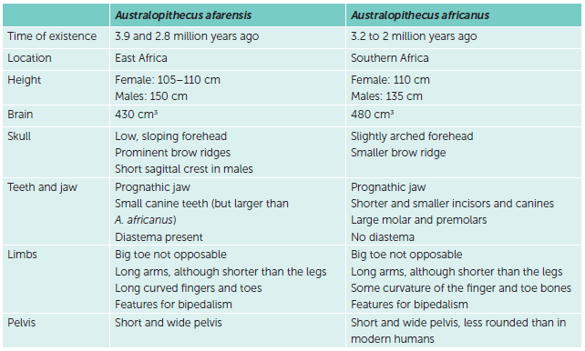
13.2 Comparison of hominin species
Australopithecus species
While there are many similarities between all australopithecines, there are also some variations, indicating the evolutionary changes.

Slide 14
13.2 Comparison of hominin species
Paranthropus robustus
Individuals in the Paranthropus robustus existed in South Africa about 1.8–1.2 million years ago. The species has been extinct for more that 1 million years. It is thought that they are not an ancestor of modern humans, but instead formed part of an evolutionary branch with no descendants.
Paranthropus robustus share many of the same characteristics as australopithecines. Some of the key features of P. robustus are:
• females' height of approximately 1 m and males’ height of approximately 1.2 m
• cranial capacity of 520 cm³
• large sagittal crest for attachment of strong chewing muscles
• very large molars and premolars, with small incisors and canines by comparison
• prognathism, although less than australopithecines
• wide, dish-shaped face with large zygomatic arches
• heavy brow ridges
• structures for bipedalism.

Slide 15
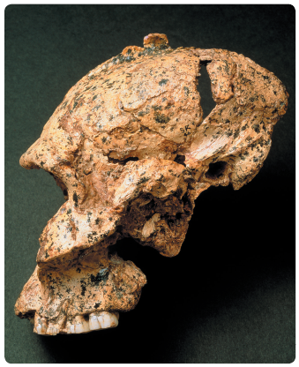
13.2 Comparison of hominin species
Science Photo Library/John Reader
A fossil of Paranthropus robustus found in 1936

Slide 16
13.2 Comparison of hominin species
Homo habilis
Homo habilis lived between 2.3 and 1.5 million years ago in eastern and southern Africa. Individuals show features between apes and humans. These include:
• females’ height of 110 cm and males’ height of 130 cm
• brain size of 610 cm³
• rounder skull
• small brow ridge
• central foramen magnum
• moderate prognathism
• teeth arranged in a rounder arc
• relatively short legs and long arms
• slightly curved finger bones, indicating a strong power grip
• able to form a precision grip.

Slide 17
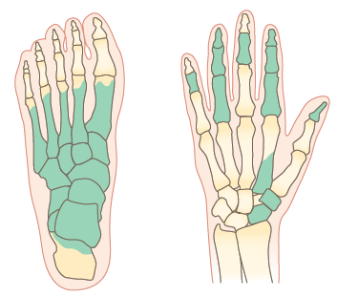
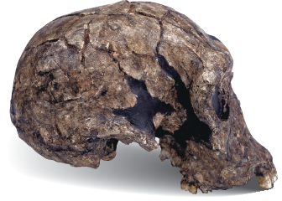
13.2 Comparison of hominin species
Science Photo Library/Natural History Museum, London
Cast of a Homo habilis skull discovered in 1973 in Kenya
Hand and foot fossil bones (shown shaded) of Homo habilis

Slide 18
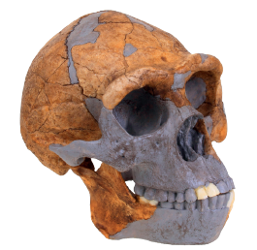
13.2 Comparison of hominin species
Homo erectus
Homo erectus were the first humans to show modern, human-like bodies, indicating a life on the ground rather than in the trees.
Some key features of Homo erectus are:
• varied height, ranging from 145 cm to 185 cm
• short, stocky body with thicker bones, suggesting a demanding lifestyle
• average cranial capacity of 1050 cm3
• low, sloping forehead
• defined brow ridges
• large, thick jaw without a chin
• reduced size of molars.
Alamy Stock Photo/imageBROKER
Reconstruction of a Homo erectus skull based on fossil remains found at Zhoukoudian Cave in China

Slide 19
13.2 Comparison of hominin species
Homo neanderthalensis
Neanderthals were a distinct biological species, Homo neanderthalensis, that existed in Europe during the last of the ice ages. At some time in the past, the lineage diverged, with one branch leading to Neanderthals and another to modern humans.
Neanderthals, while clearly human, had many features that evolved due to a cold, harsh climate. They had big faces, low but large skulls, and heavy brow ridges. The brain was slightly larger than the average for humans today, and its shape was different. The back of the skull was drawn out in a ‘bun’ shape, the lower jaw lacked a definite chin, and the cheeks were swept back to give a streamlined appearance.
The Neanderthals were short in stature, males being probably a little more than 1.5 metres in height, and females a little shorter. The limbs were short and heavily jointed with powerful muscles, so they would have appeared much more heavily built than modern humans. On top of this solid frame was a large skull containing a brain that was, on average, slightly larger than normal for modern humans.

Slide 20
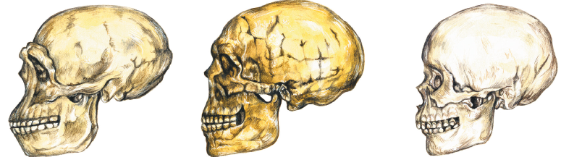
13.2 Comparison of hominin species
Science Photo Library/Christina Brodie, Visuals Unlimited
Skulls of Homo erectus (left), Homo neanderthalensis (centre) and a modern human (right)

Slide 21
13.2 Comparison of hominin species
Homo sapiens
In 1868 a number of modern human skeletons were found at Cro-Magnon in France, which became known as the Cro-Magnon people. Later discoveries suggested that these fossils were part of a once-widespread population distributed throughout Europe from 40 000 to about 12 000 years ago. The best records of this habitation date from 25 000 years ago and occur in Spain, the French Pyrenees and the Dordogne Valley in France.
Cro-Magnon people were members of our own species, Homo sapiens, and they possessed features far more modern than those of Neanderthals. In particular, their skulls tended to be shorter from front to back, higher in the region of the top of the skull and rounder at the back. Other features included less prominent brow ridges, a reduction in the projection of the face, and a smaller jaw. They had large brains, around 1350 cm³ on average, housed in skulls that were long from front to back. The face was relatively broad and short, with the orbits, or eye sockets, well separated. The teeth also tended to be smaller and a chin had developed.

Slide 22
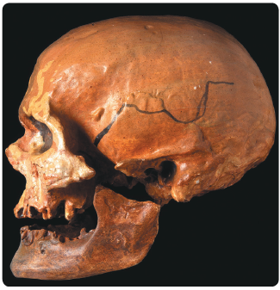
13.2 Comparison of hominin species
Science Photo Library/Natural History Museum, London
Cro-Magnon skull

Slide 23
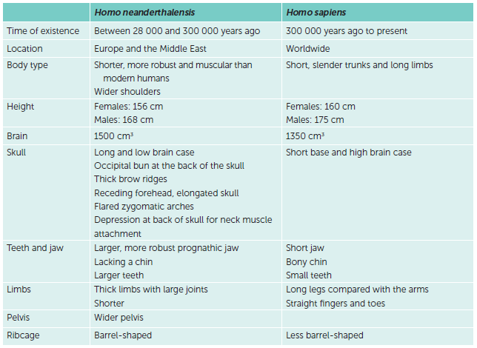
13.2 Comparison of hominin species
A comparison of Homo neanderthalensis and Homo sapiens

Slide 24
13.3 Cultural evolution
Tool use by australopithecines
No evidence of the use of fire by australopithecines has been found to date, but tool use does appear to have been common. A range of pebble tools have been found, including choppers, scrapers, flakes and chisels. These vary from about the size of a tennis ball (choppers) to that of a marble (scrapers and flakes), and are frequently referred to as Oldowan tools. To use the scrapers effectively, the precision grip must have been employed. Tools of this type have been found at sites dating back 2.5 million years.
This early tool making marked the start of a change in the way hominins interacted with their environment. They used items present in their surroundings, such as pebbles, sticks and plant material. However, there is no evidence suggesting that they changed these tools. These simple pebble tools enabled the australopithecines to exploit the resources in their environment more effectively and were the first stage in a succession of cultural changes still going on today.

Slide 25
13.3 Cultural evolution
Tool use by Homo habilis
Homo habilis continued to use Oldowan tools. Some of these were sharpened or shaped by striking one stone with another. These would have been used for activities such as skinning animals, chopping up meat, breaking open bones, crushing plants and digging up edible plant roots.
Homo habilis lived in grasslands and were hunter-gatherers. Their diet would have been primarily plant material, with supplementary meat from either scavenging or hunting.
Typically, hunter-gatherers would have worked in groups, with specific members being responsible for different tasks. Those collecting food would have brought it back to the home base to share among the members. This indicates a social organisation in Homo habilis. Communication within the group would have been important, and thus pressure for development of a spoken language would have increased. There is some evidence that early Homo had a bulge in the speech-producing area of the brain, but the larynx may not have been capable of making complex sounds.

Slide 26
13.3 Cultural evolution
Tool use by Homo erectus
By the time of Homo erectus, the effect of the environment as a selective agent was diminishing. The use of fire, the building of shelters and a range of sophisticated tools had enabled H. erectus to become more independent of the environment.
Tools manufactured by H. erectus were flaked around all of the edges, first in one direction and then in the other, until they formed roughly two-faced (bi-faced) lumps, approximately teardrop in shape. These tools were used as hand axes and are usually referred to as Acheulian tools.
Cultural changes such as the use of fire and the manufacture of tools would have influenced the social organisation of H. erectus. Greater emphasis must have been placed on mutual cooperation, and a complex society began to be established in which the care of the young would have gradually become increasingly important. A relatively complex spoken language could have arisen at this time, but is impossible to establish from the fossil record.

Slide 27
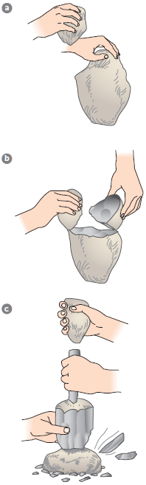
13.3 Cultural evolution
The production of flake tools: a and b show preparation of the core, and c shows how a large number of flakes can be produced

Slide 28
13.3 Cultural evolution
Tool use by Homo neanderthalensis
By the time of later hominins such as Homo neanderthalensis, further cultural advances had greatly diminished the importance of the environment in determining how and where they lived. Tool making now involved the production of stone flakes that could then be trimmed to form various cutting, scraping, piercing and gouging tools. Commonly referred to as the ‘Mousterian industry’, these tools showed a cultural advance over the Acheulian hand axe. A piece of stone was first trimmed into a disc-shaped core, and then struck by another piece of stone to produce the flakes that were flat on one side and had sharp edges. This technique is known as the Levallois technique.
The flake tools could also be joined on to a handle, spear or arrow in a process called hafting.
The Lavallois technique and hafting required planning and the ability to foresee possible outcomes. This indicates a significant development in the cognition of the species.

Slide 29
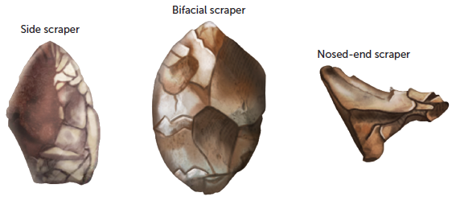
13.3 Cultural evolution
Neanderthal tools

Slide 30
13.3 Cultural evolution
Tool use by Homo sapiens
Around 50 000 years ago, new technologies associated with modern humans – finer blades and projectile weapons – began to appear. Scientists can only speculate on what triggered this technological spurt.
Whatever the cause, around 40 000 years ago modern humans moved into Europe. They brought with them innovations such as clothing, which had been sewn, and better shelters. These modern humans, known as the Cro-Magnon people, became well established in Europe and were the makers of blade tools – flakes of stone with roughly parallel sides. When the first fossil remains were found at Cro-Magnon in 1868, the tools found with them were similar to those found eight years earlier at Aurignac, which had become known as Aurignacian tools. These were blades made by removing long, flat rectangles from the core stone, which were easy to handle and effective in cutting.

Slide 31
13.3 Cultural evolution
Two other cultures are associated with later Cro-Magnon people: the Solutrean and the Magdalenian. The Solutrean culture was characterised by beautifully made willow-leaf and laurel-leaf points. These were made by carefully retouching blades produced from the original stone core by pressure flaking.
The Magdalenian cultural period, which followed the Solutrean, is known for the dominance of bone and antler tools over those of flint and stone, and for the works of art that were produced during this period. The bone and antler tools were made using a burin, or chisel-like cutter, a tool used for the manufacture of other tools. This was a significant advance in tool making: humans had devised a tool for making other tools.

Slide 32
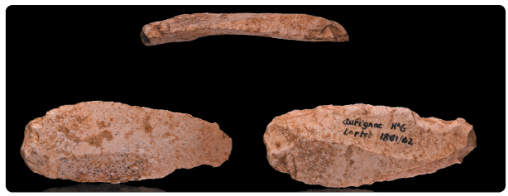
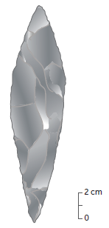
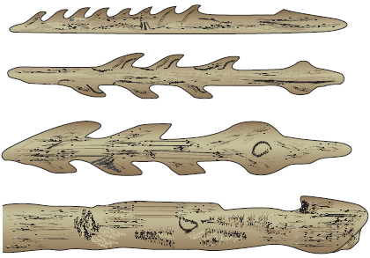
13.3 Cultural evolution
Wikimedia /Muséum de Toulouse CC BY SA-4.0 Licence
Aurignacian blade shown from three angles
Magdalenian barbed points and spear thrower (bottom) made of bone or antler
Solutrean ‘laurel-leaf’ blade

Slide 33
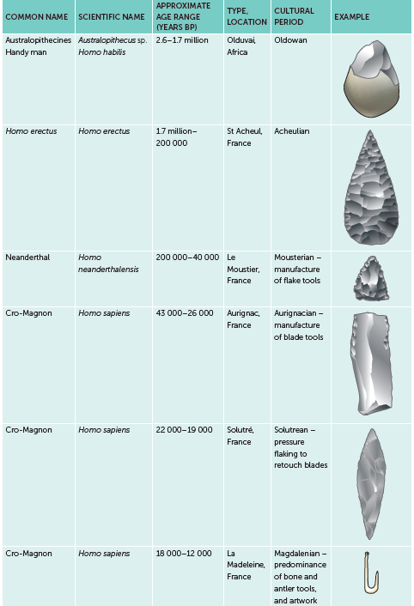
13.3 Cultural evolution
Simplified table showing approximate age ranges and cultural periods of hominins.
Note: Tool cultures frequently persisted longer than shown; for example, a simple pebble tool would have been used by modern humans if this was all that was needed for a task. Age ranges are approximations, as different ages are associated with different sites.

Slide 34
13.3 Cultural evolution
Trends in tools
During the course of human evolution, some general trends are evident:
increased manipulation of materials
increased complexity of tools
greater variety of materials being used to make tools
improved workmanship and development of equipment needed to manufacture the tools
increased specialisation of tools.
These trends, alongside structural changes during evolution, allow us to infer changes in lifestyles. Collaboration would have increased, requiring effective communication. Members within a group would have developed more specific roles and skills. Planning and creativity became important, and humans started manipulating the environment to meet their needs.

